Slide 1
Self Tuning Adaptive Regulation of a PI(D) Controller

Slide 2
Abstract
Novel Self tuning adaptive algorithm for automatic tuning of PI(D) controllers.
Aims at resolving the drawbacks of present tuning techniques.
Also supports online tuning i.e. we can change the controller parameters during the time of tuning.
The objective is to attain a design-point on the Nyquist diagram.
By injecting sinewaves and employing a PFE, closed-loop adaptive tuning is possible and there is exact convergence to the design-point without the approximations of describing-function theory

Slide 3
Shortcomings of Previous Methods:
Relay Autotuning:
Offline tuning method, no control can be provided during tuning
Load disturbances also influence the estimation accuracy
Use of describing function analysis leads to incorrect estimate of frequency point
Open Loop Tuning:
Sensitivity to disturbances
Use of parametrised process model leads to lack of generality.
Only suitable for Offline tuning

Slide 4
Expectations from Controller
The controller proposed is supposed to have positive points of relay based tuning which include its ease of use and speed.
It is also expected to have greater flexibility, giving superior PID tuning.
It must also have Robustness to:
noise,
set-point changes
disturbances .

Slide 5
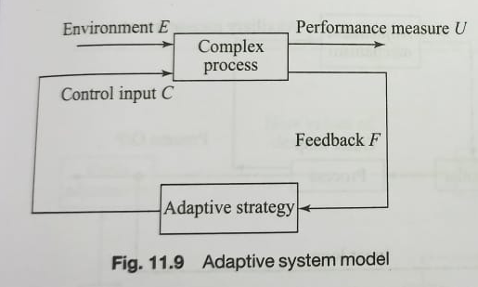
What is Adaptive Algorithm?
Aims at finding out best adjustment of controller parameters in face of changing process dynamics
Measures the performance relative to a given Index of Performance and modifies it to reach to a optimum value
Major 3 components:
Identification
Decision
Modification

Slide 6
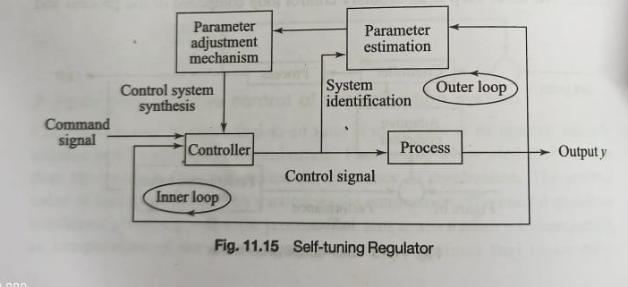
Algorithm
Self tuning Regulator
Benefits:
Flexible
Easy to understand
Easy to implement with muP

Slide 7
Algorithm
Composed of 2 loops
Inner loop
Process
Ordinary feedback controller
Outer Loop
Used to adjust the parameters of the feedback controller
Composed of
recursive parameter estimation
adjustment mechanism for controller parameter
The parameters in process are updated via online training

Slide 8
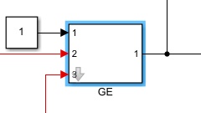
Adaptive Control: Identification
A process by which the system is characterised or by which the IP(Index of Performance) value is measured.
Here : gain estimators

Slide 9
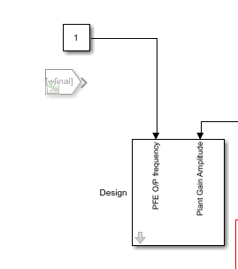
Adaptive Control : Decision
Here, the IP measurements are analysed to decide how system performance relates to the desired optimum
If performance is inadequate
Corrective adjustments are made according to the established stratergy
Here : Design Block

Slide 10
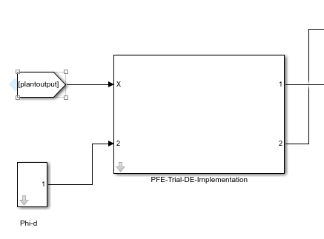
Adaptive Control : Modification
Process of changing system parameters towards the optimum setting based on the instructions received from identification and decision processes
Here : PFE(Phase/Frequency Estimator)

Slide 11
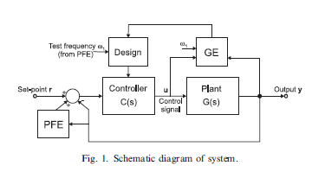
System Block Diagram
Important Blocks:
PFE Block(Phase Frequency Estimator)
GE Block (Gain Estimator)
Design Block
Controller Block
Plant Transfer Function Block

Slide 12
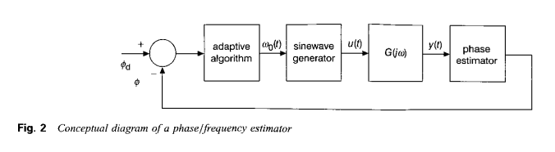
PFE
Injects a variable frequency sine wave to our system
It then changes the frequency until the desired phase margin is reached

Slide 13
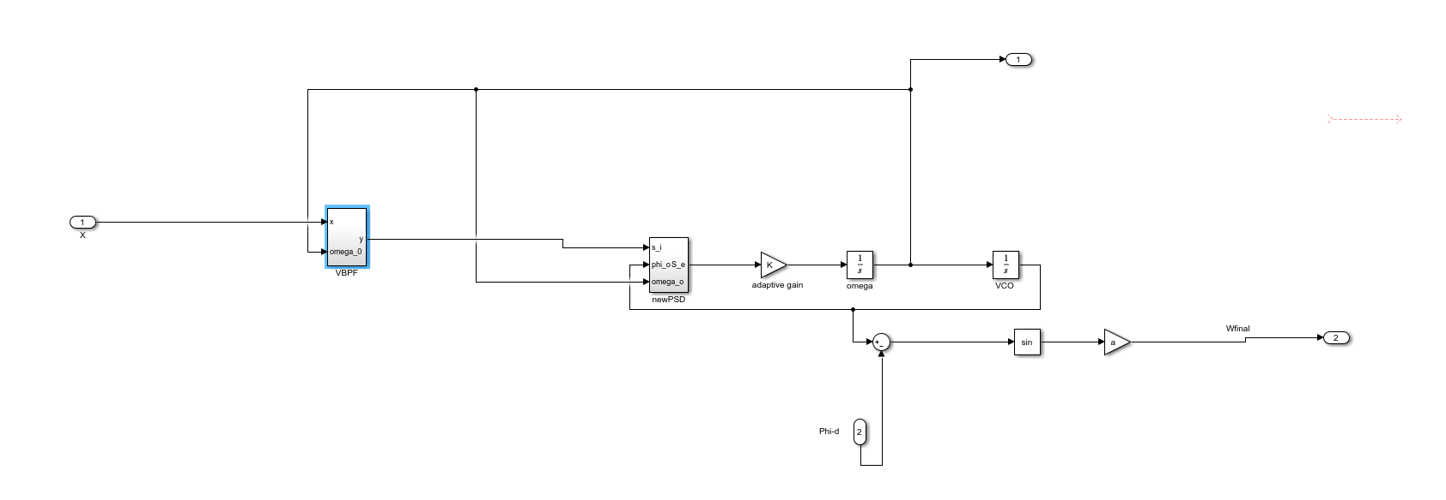
Simulation Block For PFE

Slide 14
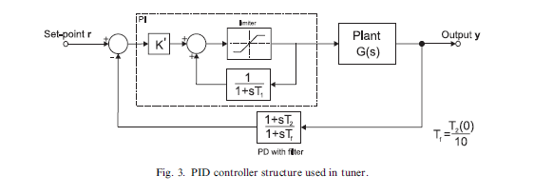
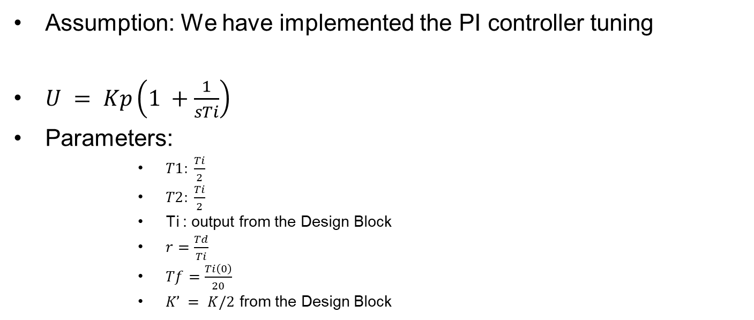
Controller
Assumption: We have implemented the PI controller tuning
$U = Kp\left(1 +\frac{1}{sTi}\right)$
Parameters:
$T1: \frac{Ti}{2}$
$T2: \frac{Ti}{2}$
Ti : output from the Design Block
$r=\frac{Td}{Ti}$
$Tf=\frac{Ti\left(0\right)}{20}$
$K’ = K/2$ from the Design Block

Slide 15
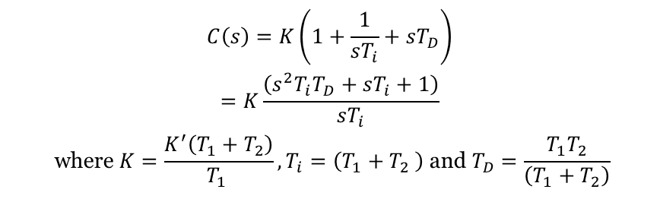
Controller
$$\begin{matrix}C\left(s\right)=K\left(1+\frac{1}{sT_{i}}+sT_{D}\right) \\ =K\frac{\left(s^{2}T_{i}T_{D}+sT_{i}+1\right)}{sT_{i}} \\ \text{where} K=\frac{K^{′}\left(T_{1}+T_{2}\right)}{T_{1 }},T_{i}=\left(T_{1}+T_{2} \right) \text{and} T_{D}=\frac{T_{1}T_{2}}{\left(T_{1}+T_{2}\right)} \\ \end{matrix}$$

Slide 16

VBPF(Variable Band Pass Filter)
Utility:
elimination of DC values;
attenuation of harmonics, arising for example if there are nonlinearities in the plant or actuator;
reduction in the effect of additive noise.

Slide 17
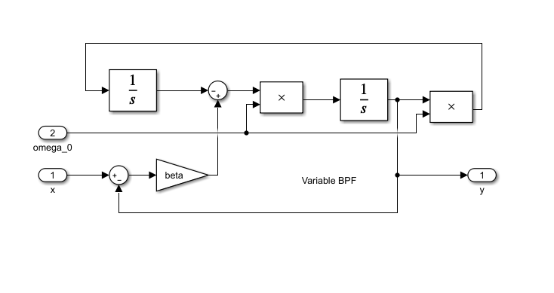
Simulation Block : VBPF

Slide 18
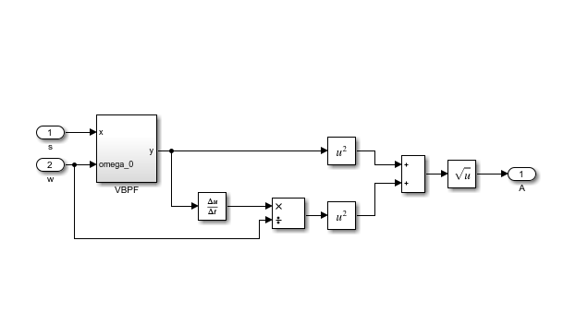
Amplitude Estimator Design

Slide 19
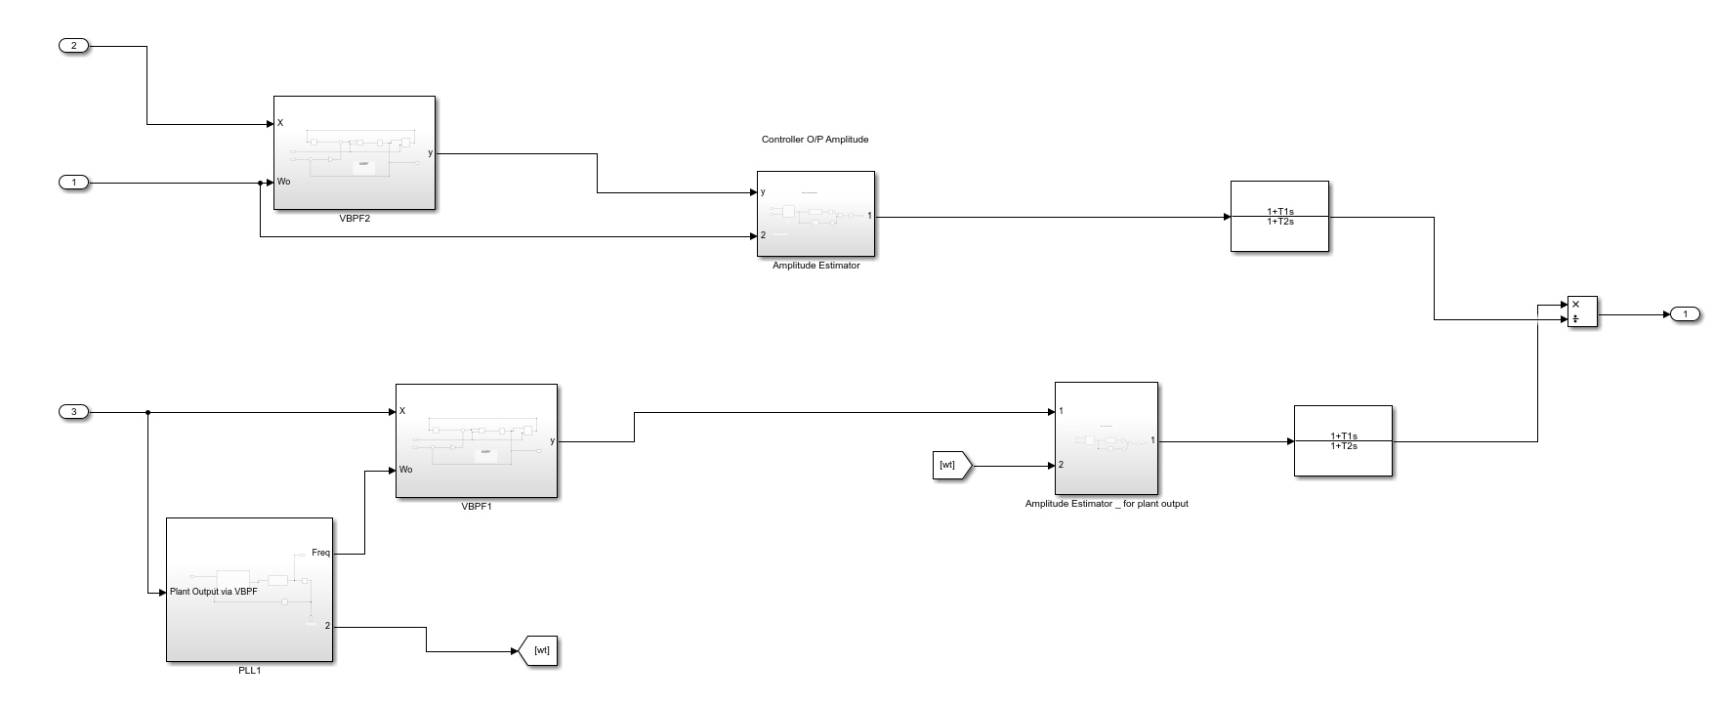
GE
Estimates the Plant Gain and thus give the output to the design block

Slide 20
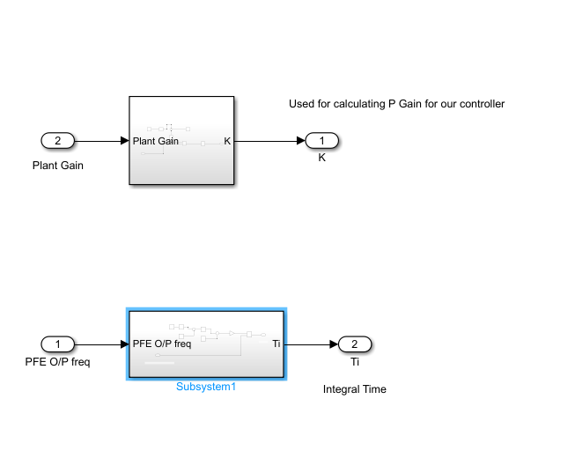
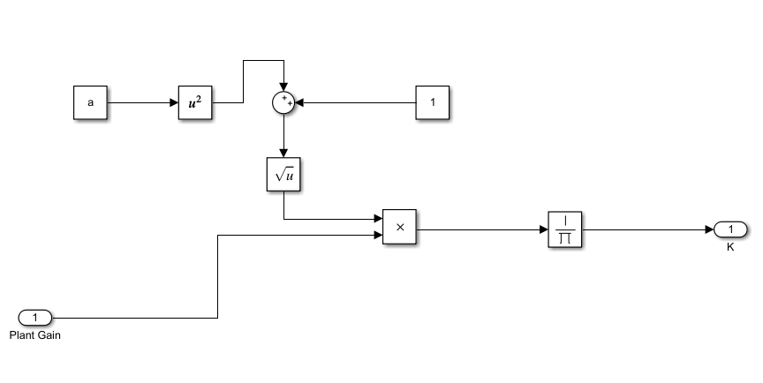
Design Block
It takes the input from GE , and calculates the Ti, and Kp using the design rules specified in the paper
K Calculation; 2K’
Calculation of K’ and Ti

Slide 21
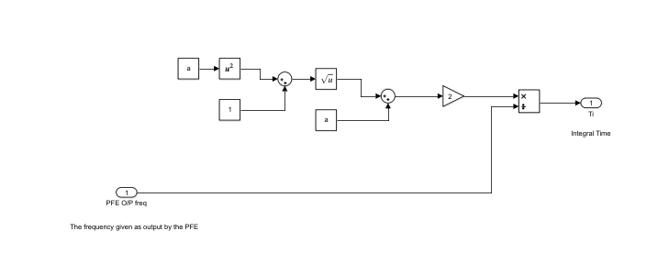
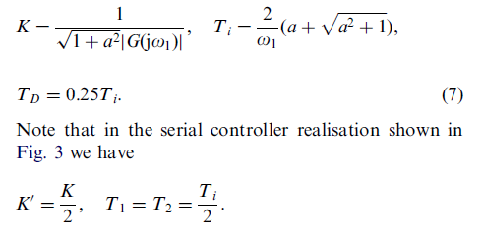
Design Block
Calculation of Ti

Slide 22
Plant
2 types of plant
Type 0 : No poles at origin
Type 1 : 1 pole at origin
3rd order and 7th order transfer functions taken
It receives the control signal from the controller and produces the plant output
This plant output and controller output is given to a GE and thus we get an estimate of the Gain

Slide 23
Adaptive Gain
This is the factor that affects how big are the steps taken by the PFE
while changing the frequency
We have directly chosen the value, (There were separate papers being written regarding the selection of Adaptive Gain)
Due to the time varying effect of the controller parameters , we scaled the adaptive gain appropriately.
For type 0 plant : 4- rescaling factor
For type 1 plant : 8 – rescaling factor

Slide 24
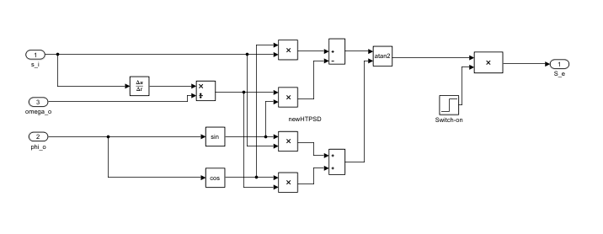
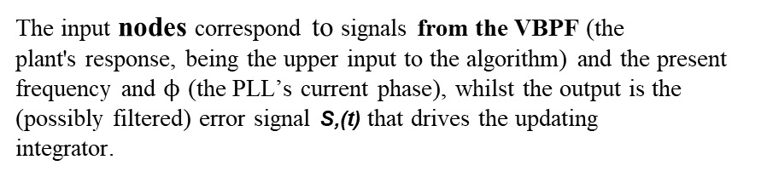
PSD
The input nodes correspond to signals from the VBPF (the
plant's response, being the upper input to the algorithm) and the present frequency and $ϕ$ (the PLL’s current phase), whilst the output is the
(possibly filtered) error signal S,(t) that drives the updating
integrator.

Slide 25
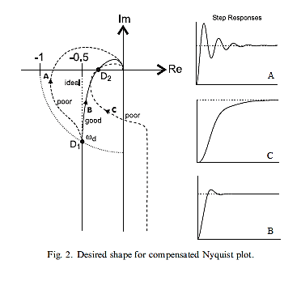
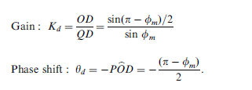
Design Point: D1
Whole algorithm depends on selection of design point D1.
Once design point D1 is selected
the corresponding desired phase margin is used to calculate the desired phase shift .
Initially, the frequency which is fed to PFE is very close to the frequency at the desired phase margin(design point)

Slide 26
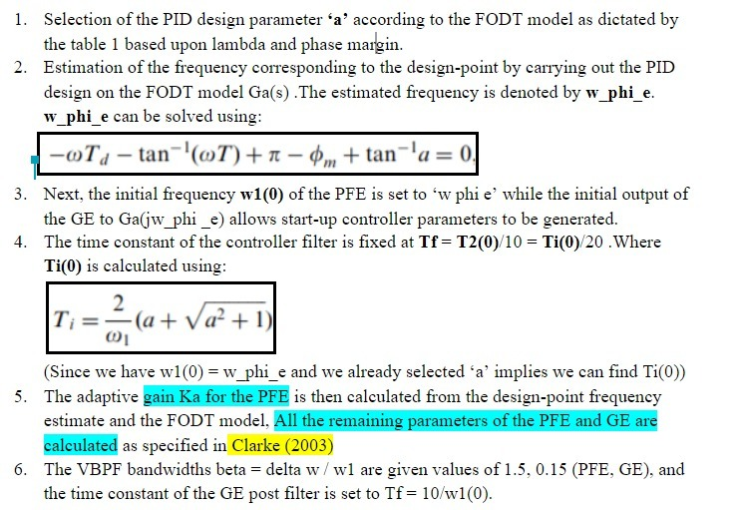

Initialisation

Slide 27
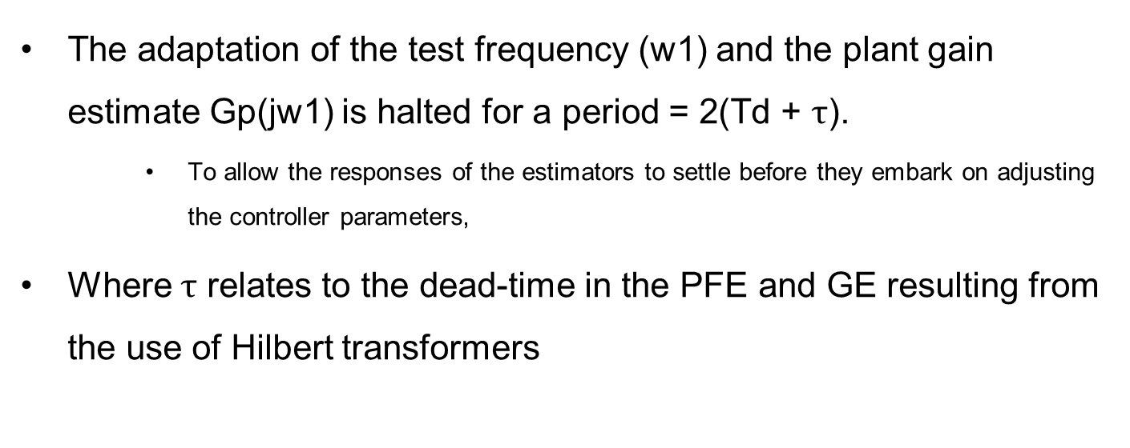
Initialisation
The adaptation of the test frequency (w1) and the plant gain estimate Gp(jw1) is halted for a period = 2(Td + $τ$).
To allow the responses of the estimators to settle before they embark on adjusting the controller parameters,
Where $τ$ relates to the dead-time in the PFE and GE resulting from the use of Hilbert transformers

Slide 28
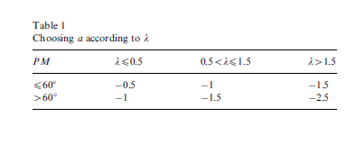
Various Formulaes/Assumptions:
Selection of parameter ‘a’:
Lambda : Td/T
Td : deadtime got from FODT model
PM : desired phase margin

Slide 29
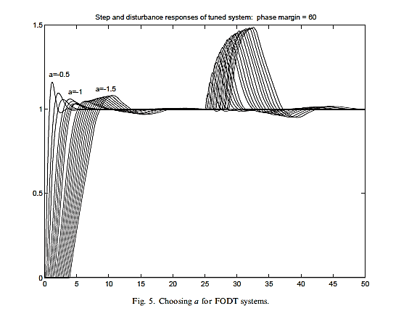

Response Based Selection
Phase Margin : 60 $°$
Graph plotted for step response for different values of a

Slide 30
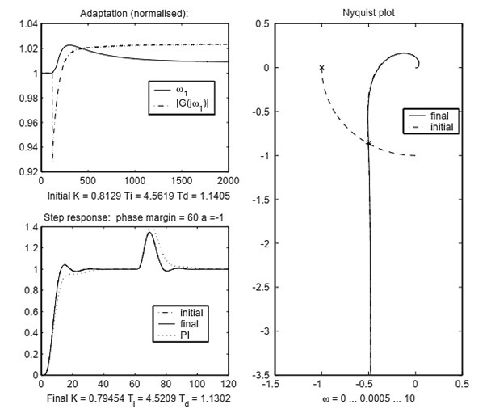
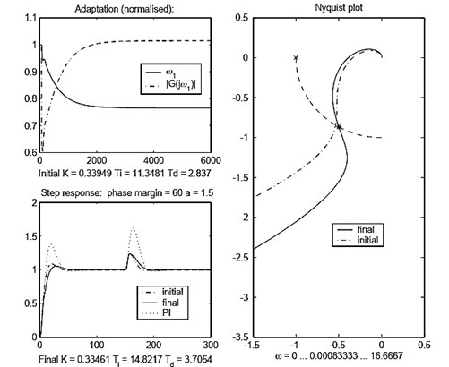
Simulation Results by Author
Simulation result for 7th order system – Type 0 plant
Simulation result for 3rd order system – Type 1 plant

Slide 31
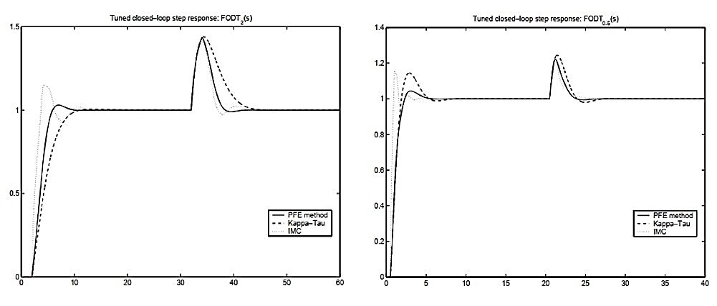
Simulation Comparisons by Author
Simulation for FODT with $λ$ = 2 $λ=$ 0.5

Slide 32
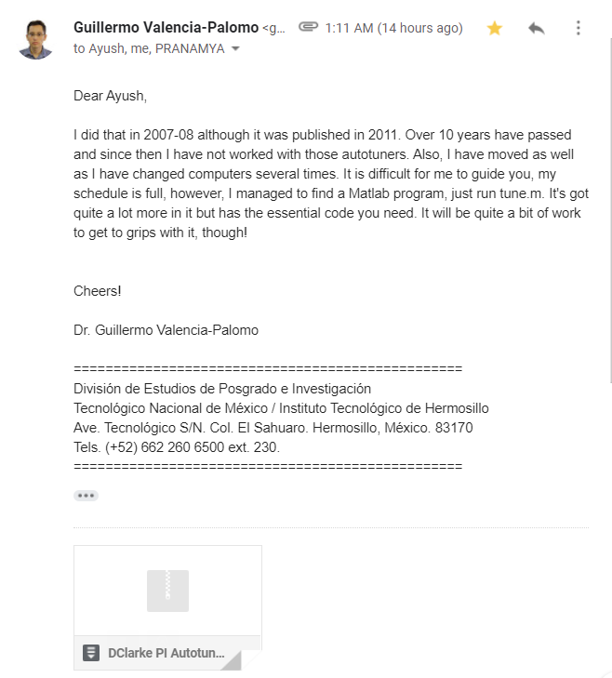

A Special Thanks….
Dr. Guillermo Valencia Palomo
Link to Profile

Slide 33
THANK YOU
-Group 17
Ayush Agrawal(2018A8PS0469P
Pranamya Jain(2018A8PS0769P)
Nitin Pant (2018A8PS0381P)

